Slide 1
Data scalability for relational graph data
Thesis presentation
Karim Anwar
Vrije Universiteit Amsterdam
Notes:
Working with big data had always its problems, specially if you are using weak/cheap hardware for data manipulation of great sizes, in this for this problem relational graph data or also know as Knowledge Bases which until this date keep on growing in size

Slide 2
Question:
By scaling (summarizing) knowledge graphs are we able to speed up R-GCN convergence?
And if so, can transfer learning be applied on the original graph using what what was learned from the summay?

Slide 3
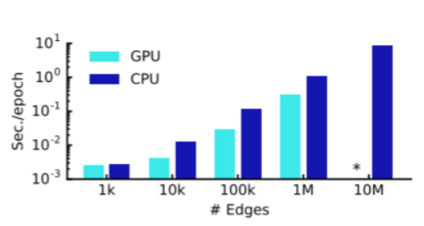
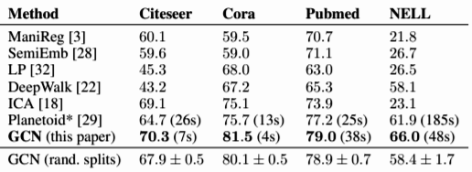
GCN
* Out Of Memory
Notes:
GCNs or Graph Convolutional Networks are a machine learning model first presented by Thomas Kipf and Max Welling in their paper “SEMI-SUPERVISED CLASSIFICATION WITH GRAPH CONVOLUTIONAL NETWORKS”.
This model was presented as a general way to apply learning on graph data but was presented with two problems which concern us:
TO BIG OF DATA (even if still working on CPU) goes OOM on GPU
For Relational data in this case the NELL dataset which was the largest one for this paper (66% since we do not consider edge direction which has information in KB)

Slide 4


R-GCN
Message passing:
GCN
RGCN
Application:
Entity classification (Encoder)
Link prediction (Encoder-Decoder)
Notes:
A 9 months later T.Kipf introduced the RGCN model with the contribution of other researchers including a professor from our University Peter Bloem.
The main difference between both models is how the messages passing is done, in the RGCN the “function” the introduction of relations to the mix which takes in consideration the the neighbors of the node it is on as well as the direction and the type of the edges
accumulates transformed feature vectors of neighboring nodes through a normalized sum. Different from regular GCNs, we introduce relation-specific transformations, i.e. depending on the type and direction of an edge.
Application necessary for KB data
DistMult

Slide 5
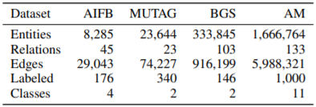
Data used
From:
“Modeling Relational Data with Graph Convolutional Networks”, Thomas N.Kipf et al.
Notes:
AIFB:
MUTAG:Each graph in the dataset represents a chemical compound and graph labels represent "their mutagenic effect on a specific gram negative bacterium".
BGS:
AM:

Slide 6
R-GCN
 | AIFB | MUTAG | BGS | AM
Test accuracy | 94.02 | 70.58 | 81.46 | OOM
Training time | 16s | 11s | 5min53s | OOM
All experiments were run on GPU with 11GB of memory in Google COLAB
Notes:
Mean test accuracy after 10 run, following
Encoder only
We can already see that we get great accuracy scores from what a GCN would provide
So RGCN are great of the analysis of Knowledge graphs.
But what would be their performance if scale them
Papers like “A Degeneracy Framework for Scalable Graph Autoencoders” and ‘Graph Summarisation of Web Data: Data-driven Generation of Structured Representations ‘ takle this problem of summarization where the first uses k-core graph degeneracy and the later bisimulation

Slide 7
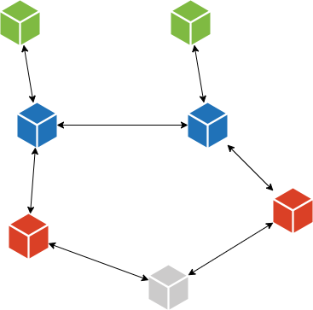
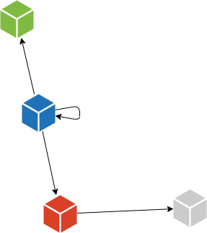
Example of summary by type
Identification
Person
Edu. establishment
City
Relation and inv. simplified

Slide 8
Dataset | Original size in memory | Sum. time | Size after sum. | Reduction factor
MUTAG | 10.2MB | 3s | 44.1 kB | 231%
AIFB | 5.95MB | 3s | 26 kB | 229%
BGS | 209MB | 2min5s | 5.94 kB | 35,285%
AM | 755MB | 1min57s | 7.79 kB | 96,919%

Slide 9
Dataset | #Nodes after | #Edges after
MUTAG | 112 | 316
BGS | 4 | 41
AIFB | 26 | 188
AM | 20 | 56

Slide 10
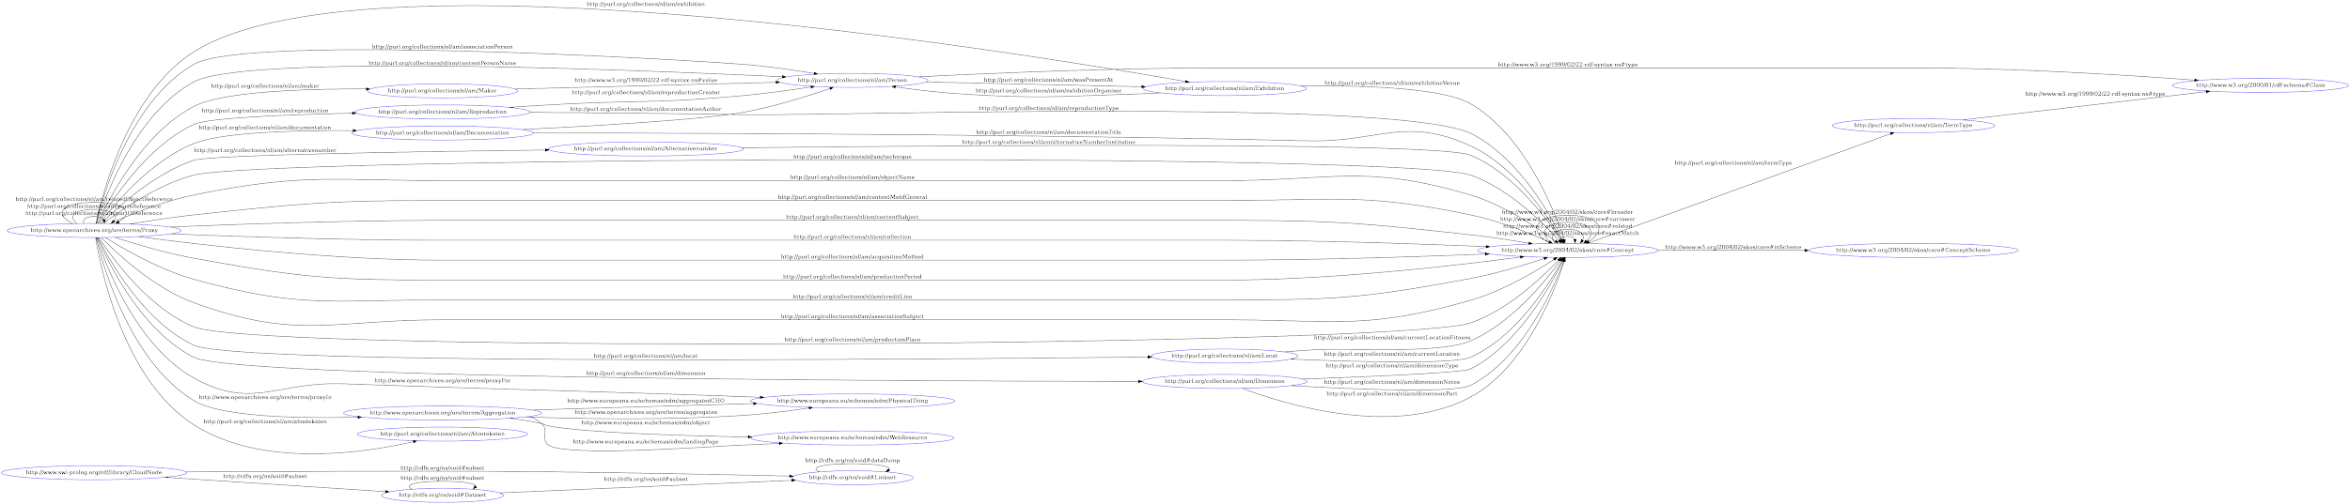
AM summarized

Slide 11
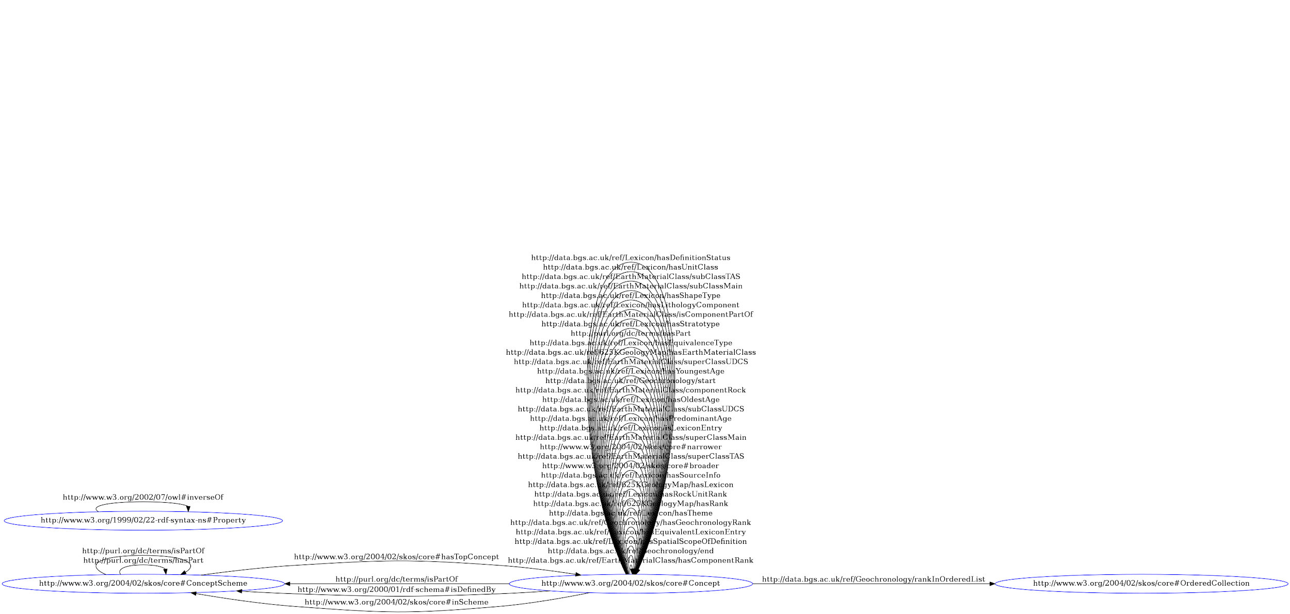
BGS summarized

Slide 12
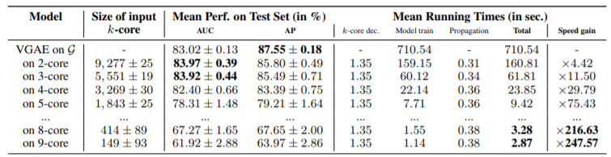
Dataset | Reduction #nodes
MUTAG | 211%
AIFB | 328%
BGS | 83,461%
AM | 83,337%
Notes:
Degeneracy framework paper
GCN AE → RCGN AE
132%
We can assume a gain of a minimum of 250x but doesn’t look promising for performance on accuraccy
Slight increase in performance ⇒ hope that Scalability when applied with transfer learning will be achieve either same or increase performance when it comes to accuracy as well as a guaranteed speed gain

Slide 13
Conclusion
The problem of weak hardware is solved when working with the summarized graphs
The is a guaranteed speed gain when it comes to testing
Hypothetically (depending on the summarization) an increase in accuracy in training and test is plausible

Slide 14
Appendix (In order of appearance)
“Semi-supervised Classification with Graph Convolutional Networks” - Thomas Kipf and Max Welling
“Modeling Relational Data with Graph Convolutional Networks “ - T.Kipf et al.
“A Degeneracy Framework for Scalable Graph Autoencoders” - Guillaume Salha et al.
“Graph Summarisation of Web Data: Data-driven Generation of Structured Representations” - Stéphane Campinas

